Slide 1
Assembly Language in NIOS II

Slide 2
Reminders
Assembly demo due Friday
No quiz this week
No lab due this week
Get your boards if you haven't already done so
Lab 1 due next week at the beginning of your lab session
See lab for late penalties
Signoffs can be received in first 15 minutes of lab session or during office hours

Slide 3
What is Assembly Language?
Low-level programming language for a computer
One-to-one correspondence with the machine instructions
Specific to a given processor
Uses:
Mnemonics to represent the names of low-level machine instructions
Labels to represent the names of variables or memory addresses
Directives to define data and constants
Macros to facilitate the inline expansion of text into other code

Slide 4
Directives
Provide information to the assembler
Do not correspond with an assembly language instruction or data
Always begin with .
Commonly used directives
.ascii “string”
A string of ASCII characters is loaded into consecutive byte addresses in the memory. Multiple strings, separated by commas can be specified
.asciz “string”
Same as .ascii, except that each string is terminated by a zero byte
.data
Identifies the data that should be placed in the data section of the memory

Slide 5
Directives
Commonly used directives
.end
Marks the end of the source code file
.equ symbol, expression
Sets the value of symbol to expression
.global symbol
Makes symbol visible outside the assembled object file
.include “filename”
Provides a mechanism for including supporting files in a source program
.space size
Allocates size bytes to be used for storage

Slide 6
Directives
Commonly used directives
.text
Identifies the code that should be placed in the text section of memory
.word expression
Expressions separated by commas are specified. Each expression is assembled into a 32-bit number
Similar .byte expression available

Slide 7
Labels
Represents the memory address of the data or instruction marked with that label
The assembler replaces each label with its memory address when generating the executable
Must start at the beginning of the line with no leading spaces
Ex: loop: #read from r2 and store to r3
ldbio r4, 0(r2)
stbio r4, 0(r3)
br loop
When this code is assembled, the memory address of the ldbio instruction will be inserted in the br instruction

Slide 8
Registers
NIOS II has 32 internal registers
Registers hold a 32 bit value
R0 always holds 0. Writing to R0 has no effect.
R1 is for the assembler – don’t use in programs
Registers r24, r25, r27, r28, r29 and r30 all have special uses by the processor
R31 holds the return address for subroutine

Slide 9
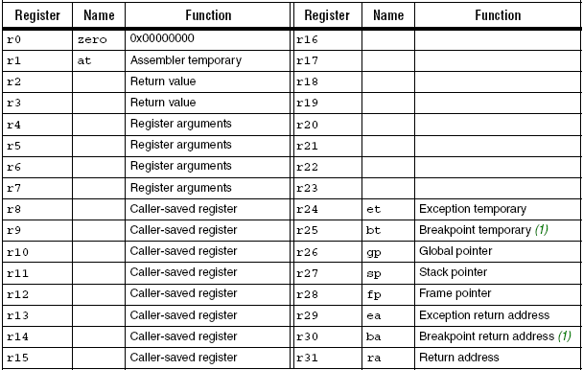
Registers

Slide 10
Instruction Types
Approximately 100 instructions
3 types
R-type : uses 3 registers
add rC, rA, rB rC <= rA + rB
sub r2, r16, r15 r2 <= r16 - r15
mul r3, r5, r6 r3 <= r5 * r6
div, and, or, nor, xor, etc….
31 27 26 22 21 17 16 6 5 0
A | B | C | OPX | OP

Slide 11
Instruction Types (Con’t)
I-type : uses 2 registers and an immediate operand
Immediate operand is a 16 bit number
addi rB, rA, IMMED16 rB <= rA + IMMED16
subi r2, r16, -4 r2 <= r16 – (-4)
muli r3, r4, 100 r3 <= r4 * 100
andi, ori, xori, etc…
No divi
31 27 26 22 21 6 5 0
A | B | IMMED16 | OP

Slide 12
Instruction Types (con’t)
J-Type
Does not use registers
Has a 26 bit immediate operand
Immediate operand is the address of a subroutine
Only call instruction
call IMMED26
call $0231F0C4
call Subroutin2
31 6 5 0
IMMED26 | OP

Slide 13
Common Instructions
Arithmetic
add, addi
sub, subi
mul, muli
div, divu (divide unsigned)
Logic
Bitwise operations
and, andi
or, ori
nor, nori
xor, xori

Slide 14
Common Instructions (con’t)
Comparison
cmpeq rC,rA,rB // rC <= 1 if rA = rB
cmpne rC,rA,rB // rC <= 1 if rA != rB
cmplt rC,rA,rB // rC <= 1 if rA < rB
If comparison is not true, rC <= 0
Other options for unsigned comparisons
Immediate comparisons also exist
cmpeqi rB,rA,IMMED16 //compares rA to constant
cmpnei rB, rA,IMMED16
Etc..

Slide 15
Common Instructions (con’t)
Shifts
srl rC,rA,rB rC <= rA >> rB
srli rC,rA,IMMED5 rC <= rA >> IMMED5
sra rC,rA,rB rC <= rA >> rB
srai rC,rA,IMMED5 rC <= rA >> IMMED5
Logical shifts fills vacated bits with 0’s
Arithmetic shifts extend the sign bit on the left
Rotates
ror rC,rA,rB
rol rC,rA,rB
roli rC,rA,IMMED5
Rotate differs from a shift in that the bits shifted out of one end are wrapped around to the other end

Slide 16
Common Instructions (con’t)
Unconditional Branch
br LABEL
I-type instruction. Immediate operand (16bits) is the offset from current program location to LABEL
Conditional Branch
blt rA,rB,LABEL //branches if rA < rB
beq rA,rB,LABEL //branches if rA = rB
Also unsigned comparison

Slide 17
Memory Access
source
Read: ldw r3, 4(r5) //copies value from memory to r3
Write: stw r3, 4(r5) //copies r3 value to memory
Ex: If r5 contains the value 0x100, then the memory location accessed for both the ldw and stw would be 0x104.
Effective address: adds constant 4 to
contents of r5 to form the address
destination

Slide 18
Load and Store
No ldi or sti (immediate load or store)
How do you put 0x100 into r5?
addi r5, r0, 0x100
For memory access
ldw, stw : load and store word
ldb, stb : load and store byte
ldh, sth : load and store half word
For memory mapped io
ldwio, stwio, ldbio, stbio, ….
Bypasses the cache

Slide 19
Memory Structure
Memory is organized in words
32 bits or 4 bytes
Each word has an address
Why do the addresses jump by 4?
Address | Data
0x0000 | 32 bit value
0x0004 | 32 bit value
0x0008 | 32 bit value
0x000C | :
: | :
: | :
0xFFFC | :

Slide 20
Memory Structure (con’t)
Because data is byte addressable memory effectively looks like this:
Address | Data
0x0000 | 8 bit value
0x0001 | 8 bit value
0x0002 | 8 bit value
0x0003 | 8 bit value
0x0004 | :
: | :
0xFFFC | :

Slide 21
Memory Structure (con’t)
Consider the following data:
It is stored like this:
Address | Data
0x0000 | 0x12345678
0x0004 | 0xABCDEF00
LSB has smallest address:
called little endian
Address | Data
0x0000 | 0x78
0x0001 | 0x56
0x0002 | 0x34
0x0003 | 0x12
0x0004 | 0x00
0x0005 | 0xEF
What value is put into r3 with the following
instruction, assuming r5 contains 0x0001?
ldw r3, 2(r5)

Slide 22
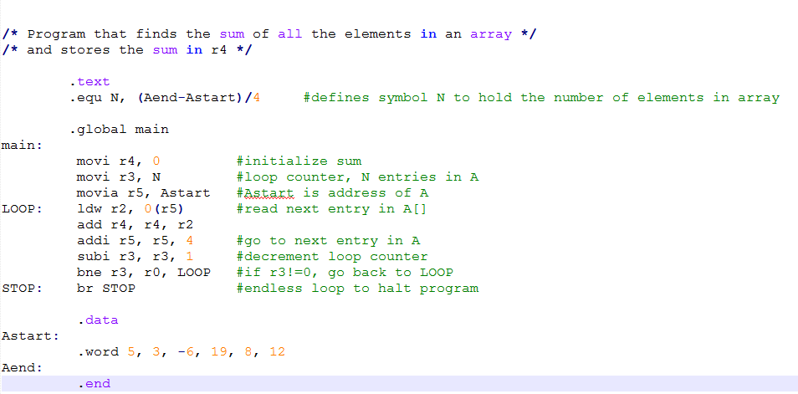
Example code

Slide 23
Subroutines
Similar to a function call in C
Execution leaves the main program and jumps to a code segment that performs a specific function
Especially useful if there is a function that needs to be done several times in a program
Must end with ret

Slide 24
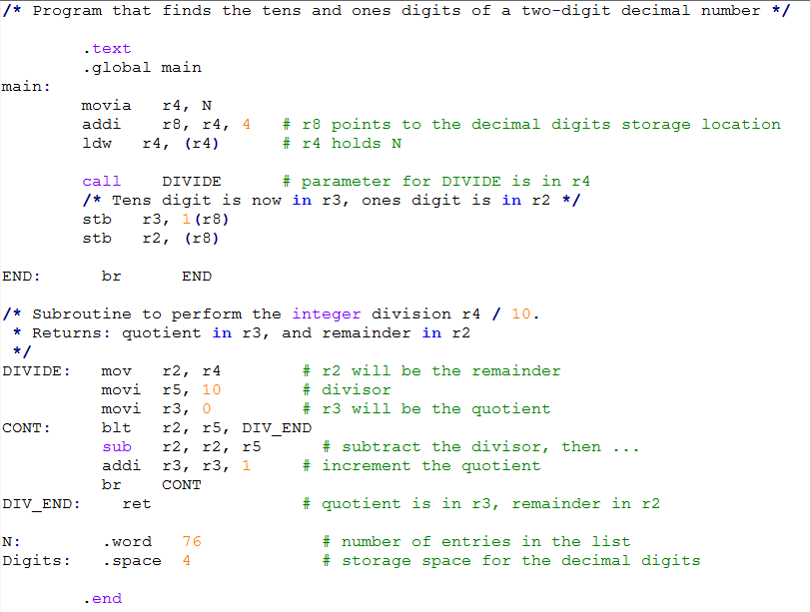
Subroutine Example

